Slide 1
Machine learning graphs
I didn’t really have place to put information about what the graphs are so I put them in the presentation notes

Slide 2
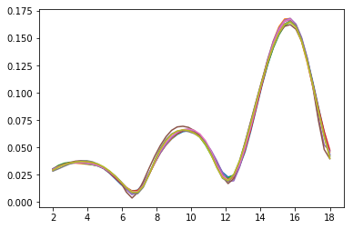
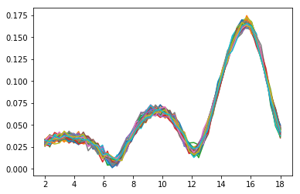
Fake Data
Real Data
Notes:
When I sorted all our data into nested dictionaries, it became clear I did not have enough data at all to train a machine learning algorithm on. Because of this, we added/subtracted random values to existing data to create new lines. It is a lot noisier, but it works quite well.

Slide 3
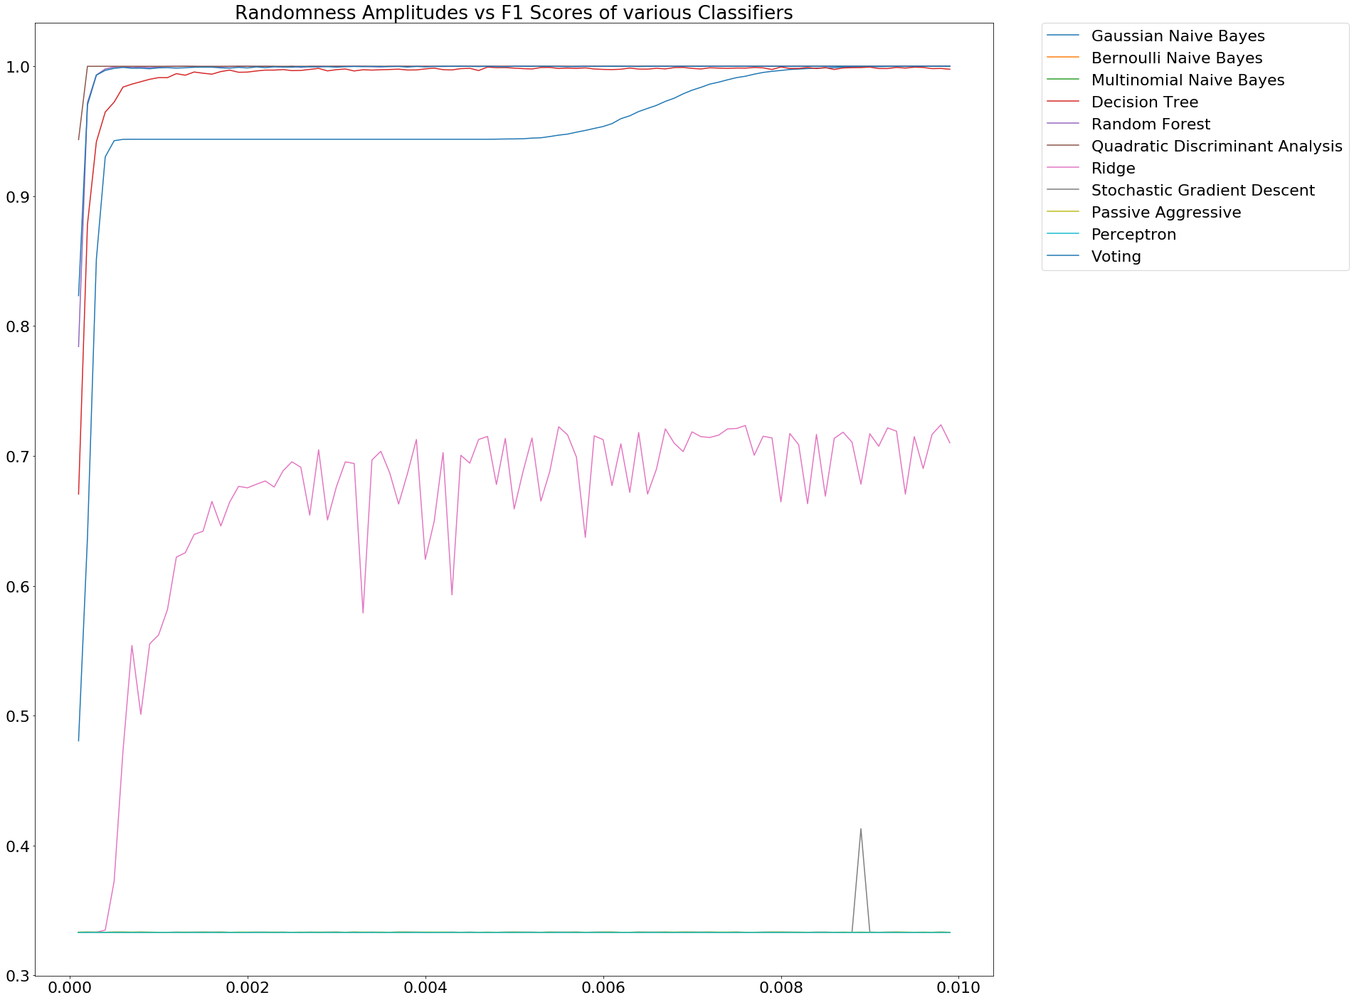
Notes:
After doing some tests, I realized I was just arbitrarily picking a classifier to use for each machine learning problem I did. Because of this, I decided to make a bunch of bad data by adding random noise to magS22 data, with the max amplitudes of the noise being called the “randomness amplitude”. I then made a graph of randomness amplitudes vs F1 scores of different classifiers, to find out which classifiers were doing the best.

Slide 4
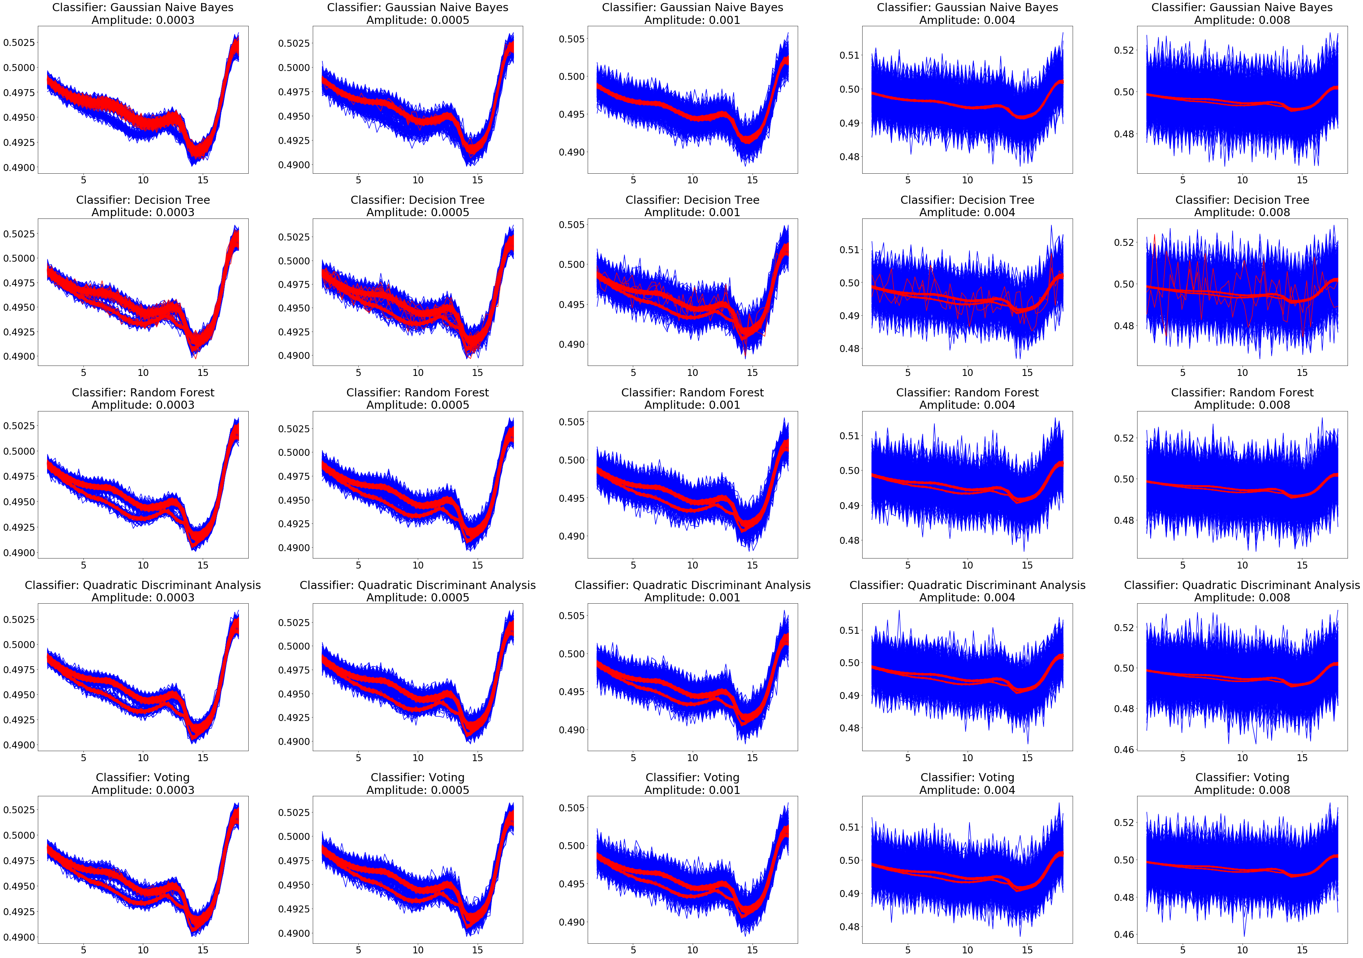
Notes:
I then graphed the predicted good vs predicted bad values of different classifiers on the data discussed in the previous slide. I just selected 5 randomness amplitudes that seemed good, and graphed the results with different classifiers. Datasets that are predicted good by the classifiers are red, and Datasets that are predicted bad by the classifiers are blue.

Slide 5
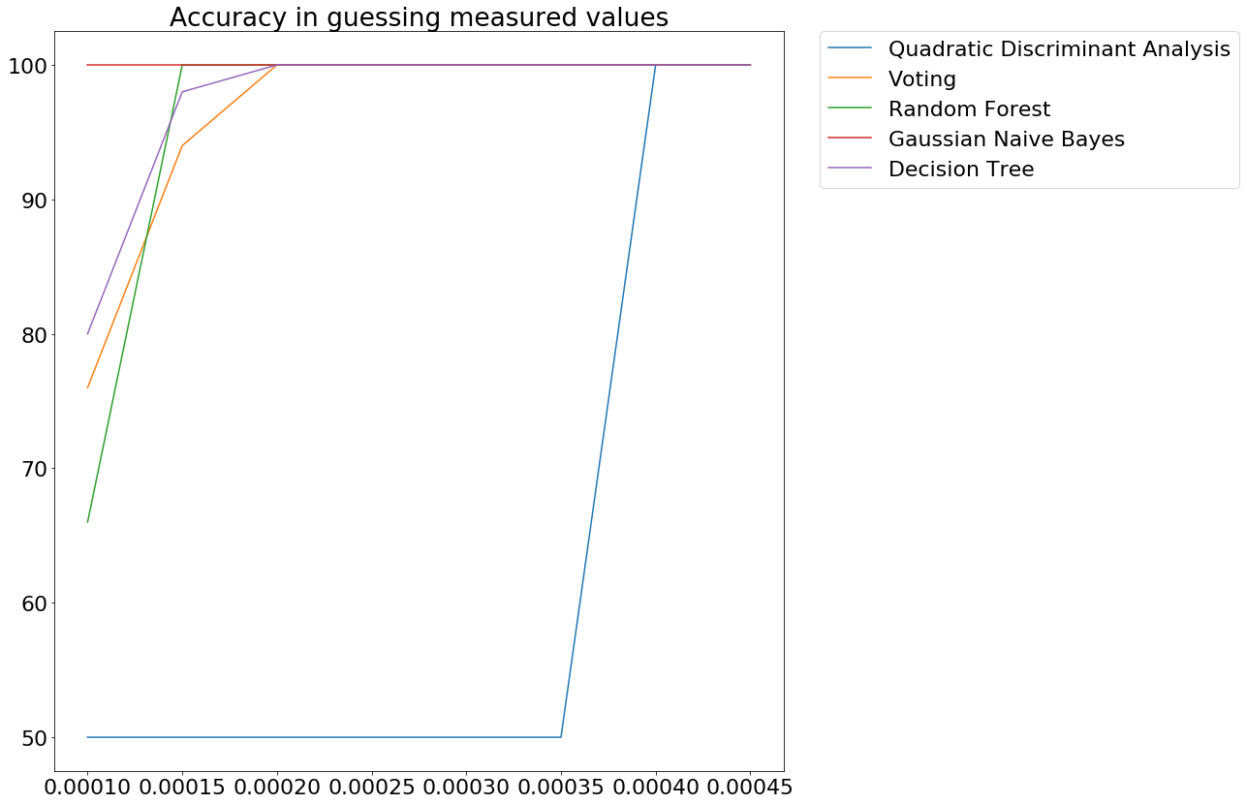
Notes:
Aric said it would be a good idea to exclude some values as bases for fake data creation then test whether the classifiers can correctly say the measured values are valid. I took this idea a bit farther and made this graph. Basically, I excluded two datasets from the fake data creation, then trained and tested classifiers using fake data and these excluded datasets 25 times each. The graph shows what percentage of the time the different classifiers correctly labelled the excluded datasets as valid, at different randomness amplitudes for magS21 values.

Slide 6
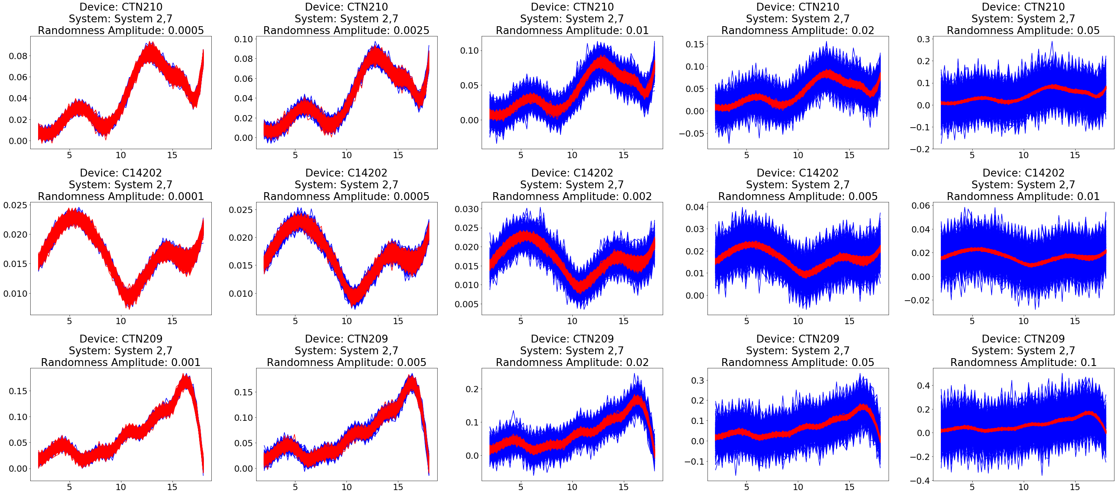
Classifier: Random Forest
Notes:
I decided to try testing a classifier on data from different devices and systems, so I generated random noise on fake data and graphed predicted good datasets as red and predicted bad datasets as blue.

